Slide 1
Energy Storage and Electric Vehicles Module 7

Slide 2
Energy Storage and Electric Vehicles Module Outline
Part 1: General Information
Background
Forms of energy storage
Deployments of energy storage
Part 2: Energy Storage Uses
Peak shifting
Generation shifting
Ancillary Services
Part 3: Electric Vehicles
Impacts on distribution grid
Usage potential
Storage considerations
Implementation issues

Slide 3
Part 1: General Information
Background
Forms of Energy Storage
Chemical Storage
Physical Storage
Deployments of Energy Storage
Grid Tied
Grid Influencing

Slide 4
Background
Electric load continues to grow, and generation and transmission capabilities are becoming unable to meet these new demands.
Environmental and economic concerns often make generation and transmission creation difficult to accomplish.
“Modern Grid” and “Smart Grid” applications look at incorporating new technologies and communication systems to more efficiently operate the system, as opposed to increasing capacity.

Slide 5
Background (continued)
Energy storage technology can help enhance system reliability, aid power transfer, and maintain power quality.
Ideally, Energy Storage Technology could:²
Be means to rapidly damp oscillations
Respond to sudden load changes
Supply load during transmission or distribution interruptions
Supply load outside of ideal generation hours
Correct load voltage profiles with rapid reactive power control
Allow generators to balance load at their normal speed

Slide 6
Forms of Energy Storage
Chemical Storage
Electrochemical processes (batteries)
Physical Storage
Fluids
Momentum
Heat
Electric fields

Slide 7
Chemical Energy Storage
Batteries are one of the most cost-effective storage technologies available
Become charged by undergoing internal chemical reactions, and discharge when reversing the reaction
Cannot operate at high power levels for long time periods
Battery lifetime reduced in accordance with frequency of deep discharges
Environmental concerns because of chemicals involved
Storage and disposal of hazardous materials can cause issues
Battery types:
Sodium Sulfur (NaS)
Lithium Ion (Li-ion)
Lead-Acid (L/A)
Zinc Bromine (ZnBr)
Vanadium Redox
Nickel Cadmium (NiCd)
Nickel Metal Hydride (NiMH)

Slide 8
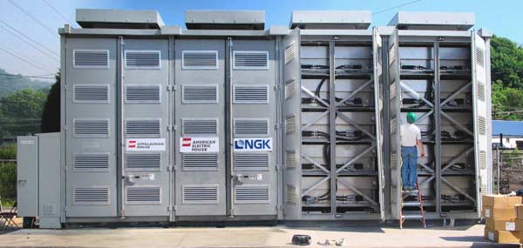
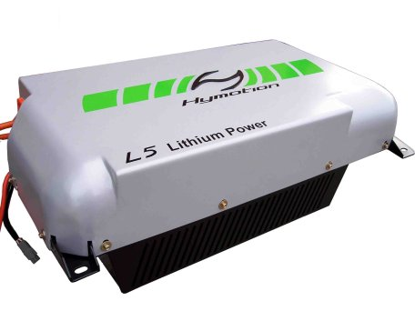
Battery Technologies ³
Sodium Sulfur (NaS)
High power output
High efficiency
Good cycle life
Low maintenance
Commercially immature
www.technoologyreview.com
Lithium Ion (Li-ion)
High energy density
Recycled/Reused PHEV batteries
Rapidly developing technology
Relatively expensive
Low cycle life
www.greencar.com
3. Jason’s Slides

Slide 9
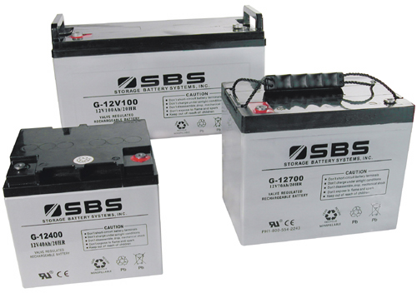
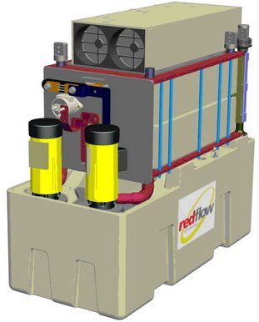
Battery technologies³
Lead-Acid (L/A)
Commercially very mature
Low cost of installation
Low conversion efficiency
Very poor cycle life
Low energy density
www.sbsbattery.com
Zinc Bromine (ZnBr)
Easy relocation
Commercially immature
Medium cycle life
Medium cost
Larger footprint
www.wikipedia.org
3. Jason’s Slides

Slide 10
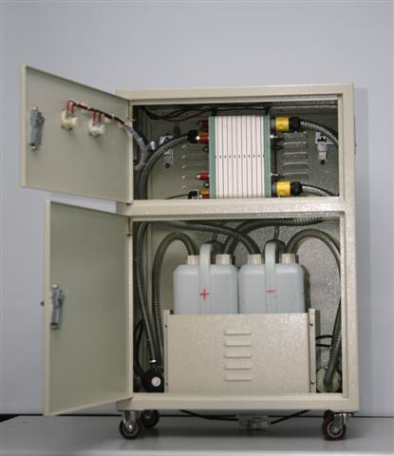
Battery technologies³
Vanadium Redox Battery
Fast load response
High efficiency
Good cycle life
Commercially immature
Low energy density
www.flikr.com
Other Technologies
Nickel Cadmium (NiCd)
Nickel Metal Hydride (NiMH)
3. Jason’s Slides

Slide 11
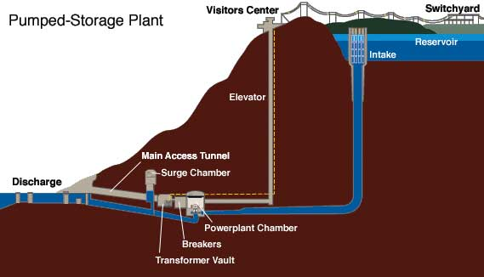
Physical Energy Storage: Fluid Storage
Pumped Hydro⁴: Pumped Hydro plants store and generate energy by moving water between reservoirs at different elevations.
When electricity demand is low, water is pumped to the upper reservoir, then during high electricity demand, water is released into the lower reservoir through turbines which generate energy.
4. http://hydro.org/tech-and-policy/technology/pumped-storage/

Slide 12
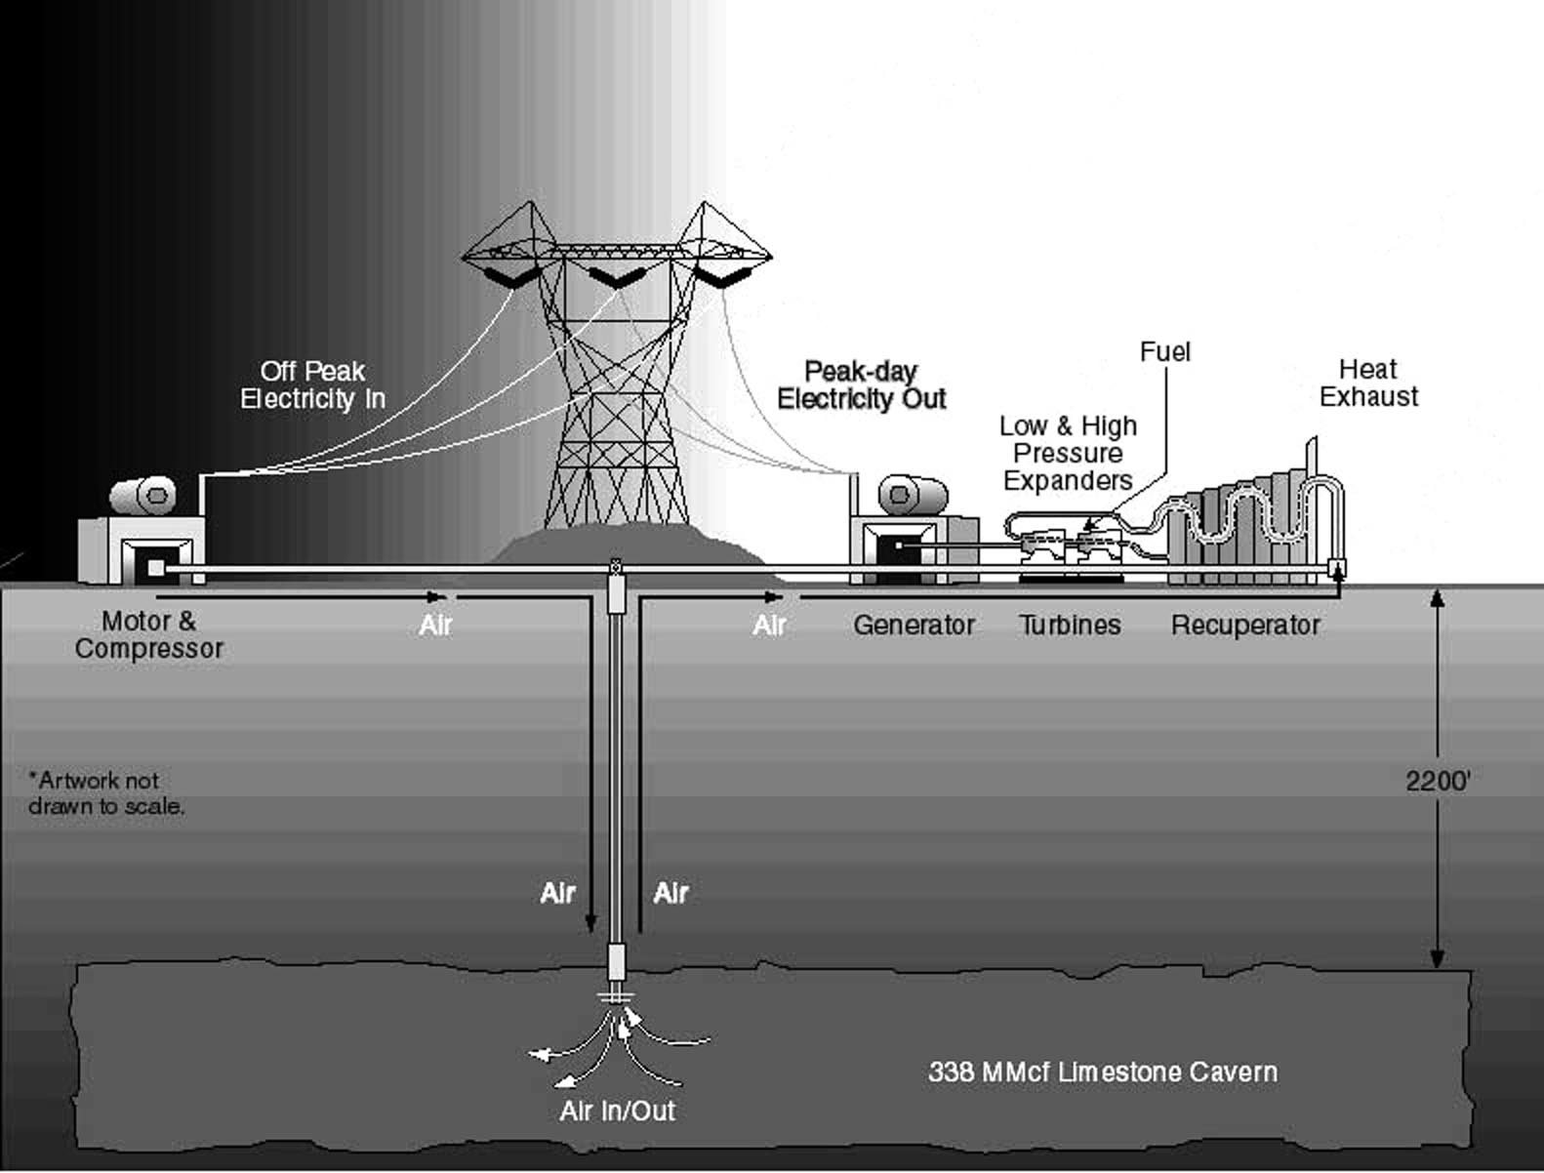
Physical Energy Storage: Fluid Storage
Compressed Air (CAES)⁵: Energy is stored when air is compressed, cooled, and stored at high pressure in a sealed container. That stored energy is converted back to electricity by using the compressed air in a turbine.
Compressed air is stored
in underground caverns
http://en.wikipedia.org/wiki/File:Minebw.jpg
5. Taylor, J.; Halnes, A.; , "Analysis Of compressed air energy storage," PCIC Europe 2010 Conference Record , vol., no., pp.1-5, 15-17 June 2010

Slide 13
Physical Energy Storage: Momentum
Flywheel¹:
Storage system where energy is stored in the kinetic energy of a rotating mass– a rotor that converts energy between electrical and mechanical forms.
In the flywheel system, the rotor operates in a vacuum.
Steel-rotor systems rely mostly on mass of rotor, while composite (resin/glass or resin/carbon-fiber) flywheels rely more on speed.
Advantages:
Minimal operation and maintenance (O&M) requirements
Compact and self-contained
No hazardous chemicals or flammable gasses
Disadvantages:
Challenges related to rotating energy equipment– site selection, material selection and testing
1. Boyes, J.D.; Clark, N.H.; , "Technologies for energy storage. Flywheels and super conducting magnetic energy storage," Power Engineering Society Summer Meeting, 2000. IEEE , vol.3, no., pp.1548-1550 vol. 3, 2000

Slide 14
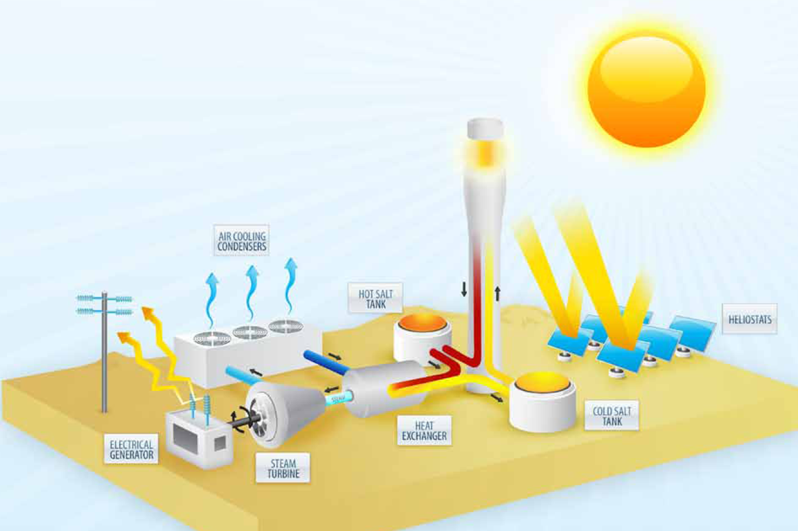
Physical Energy Storage: Heat
Ice Energy: Ice is produced during times of low energy demand, and then used to air condition the building during times of higher energy demand.
Molten Salt⁶:
In a concentrating solar power plant, thermal energy is stored in the molten salt, then passes through a heat exchanger to create superheated steam, which generates electricity via a turbine.
6. Dunn, R. I.; Hearps, P. J.; Wright, M. N.; , "Molten-Salt Power Towers: Newly Commercial Concentrating Solar Storage," Proceedings of the IEEE , vol.PP, no.99, pp.1-12, 0 doi: 10.1109/JPROC.2011.2163739

Slide 15
Physical Energy Storage: Electric & Magnetic Fields
Superconducting Magnetic¹:
Has a coil of superconducting wire that the direct current flows through, creating the magnetic field that stores the energy without converting it to chemical or mechanical forms.
Must operate at cryogenic temperatures to stay superconductive
Advantages:
Can both release large quantities of power and fully recharge quickly, thus is efficient and economical
Highly mobile devices
No hazardous chemicals or flammable gasses
Disadvantages:
Produce large magnetic fields
Potential to rapidly pressurize if coils become non-superconducting
1. Boyes, J.D.; Clark, N.H.; , "Technologies for energy storage. Flywheels and super conducting magnetic energy storage," Power Engineering Society Summer Meeting, 2000. IEEE , vol.3, no., pp.1548-1550 vol. 3, 2000

Slide 16
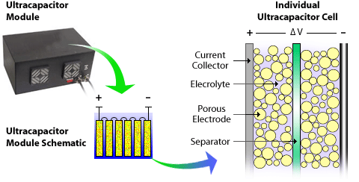
Physical Energy Storage: Electric & Magnetic Fields
Ultracapacitors⁷:
Stores energy electrostatically by physically separating positive & negative charges—unlike batteries which do so chemically.
Advantages:
Very fast charge and discharge times
Long operational life– may be charged and
discharged hundreds of thousands of times
High efficiency
Environmentally friendly
Disadvantages:
Low specific energy
Commercially immature
http://www.nrel.gov/vehiclesandfuels/energystorage/ultracapacitors.html
7. http://www.ultracapacitors.org/index.php?option=com_content&Itemid=57&id=37&task=view

Slide 17
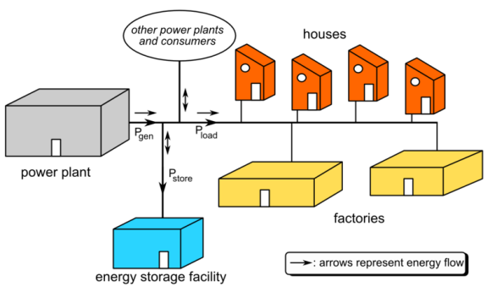
Deployments of Energy Storage: Grid Tied
Transmission
NaS
NiMH/Li-ion
Pumped Hydro
Compressed Air
Uses
Renewable integration
Reconcile intermittency in power generation
Short-term backup
Fast response load pickup
Grid stabilization
http://en.wikipedia.org/wiki/File:Grid_energy_storage.png

Slide 18
Deployments of Energy Storage: Grid Tied
Distribution
Community Energy Storage
NiMH/Li-ion
Secondary use of PHEV batteries
Uses
Demand/generation shifting
Renewables integration
Short-term backup
Fast load pickup

Slide 19
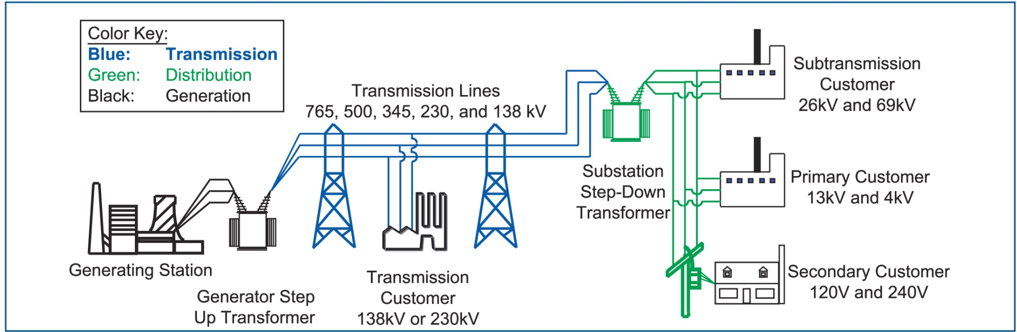
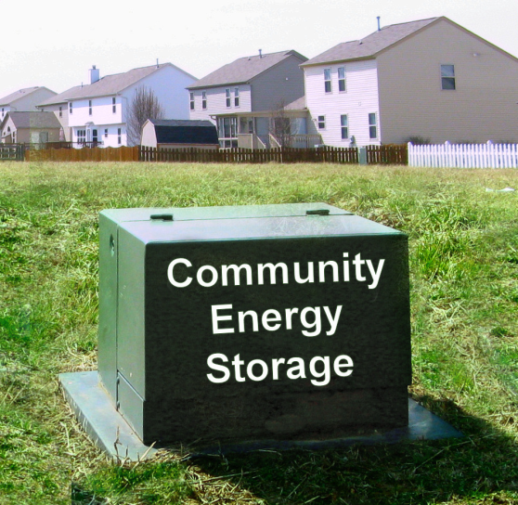
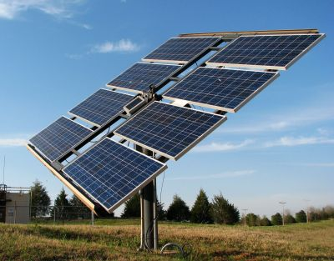
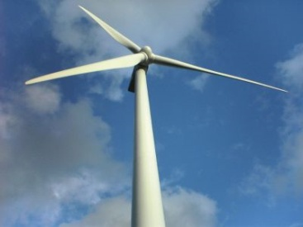
What is Community Energy Storage (CES)?
3. Jason’s Slides
www.icandoitmyself.com
www.aeptechcentral.com

Slide 20
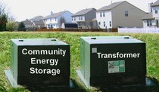
Why Community Energy Storage?
Advances in battery technology are beginning to make it cost effective
Enhancement of distributed / renewable generation support
Incentives are being provided by government and utilities
Reduced equipment costs / deferral of system upgrades
Improved reliability and temporary islanding support
Peak shaving / congestion management
Provides power directly to the load
Load response to market signals
Reduced system losses
Power quality control
Local voltage control
www.aeptechcentral.com
3. Jason’s Slides

Slide 21
Community Energy Storage: Electric Vehicles
Battery types
NiMH
Li-ion
Uses
Same as community energy storage
Transmission-level benefits – ability to provide regulation capabilities
Differences from other community energy storage
Availability
Customer constraints (charging needs, etc.)

Slide 22
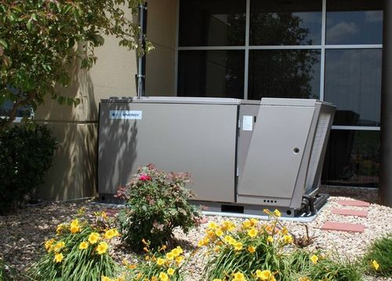
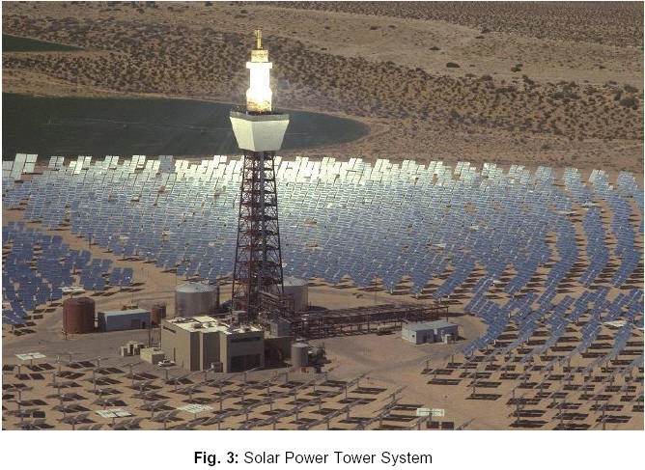
Deployments of Energy Storage: “Grid Influencing”
Ice Energy Storage
Distribution level
Tied into HVAC units
Uses
Demand shifting/peak reduction
Customer peak Utility peak
Molten Salt Storage
Typically transmission level
Tied to solar-thermal plants or waste-heat producers
Uses
Off-peak power production
Power output stabilization (Renewables Integration)
http://www.ice-energy.com
http://ec.europa.eu/energy/res/sectors/solar_thermal_power_en.htm

Slide 23
Part2: Energy Storage Uses
Distribution Level
Peak Shifting
Ancillary Services
Regulation
Load Following

Slide 24
Energy Storage Uses Distribution Level: Peak Shifting
Purposes
Reducing customer load during “expensive” power periods
Reducing customer load during peak utility periods
Possible carbon impacts ← extremely region/instance dependent
Implementations include:
Thermal Energy Storage
Community Energy Storage

Slide 25
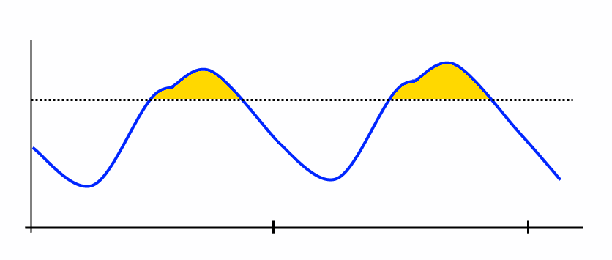
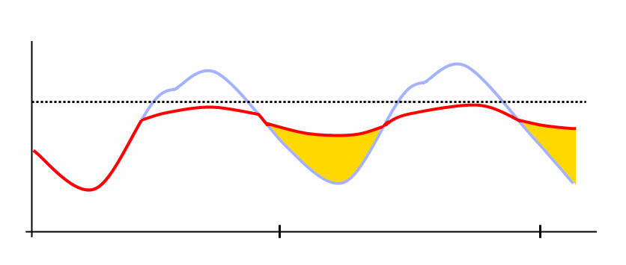
Energy Storage Uses Distribution Level: Peak Shifting – Example
“Valley Filling”
Shift energy consumption from high demand time to low demand time

Slide 26
Energy Storage Uses Distribution Level: Ancillary Services
Distribution-level deployment, but transmission-level benefits
Aggregated populations, or single installations
Regulation and load-following abilities

Slide 27
Ancillary Services: Regulation
Necessary Capabilities
Fast charge/discharge (4 seconds)
Varying power output levels
Not necessarily large capacity
Smooth intermittent power from renewables integration
Devices
Batteries
CES
Renewables-integration (smooth localized renewables)
PHEVs
Flywheel
Pumped Hydro or Compressed Air (Small scale theoretically possible, but not practical so far)

Slide 28
Ancillary Services: Load Following
Necessary Capabilities
Medium charge/discharge response time (minutes)
Varying power output levels
Larger capacity
Devices
Batteries
CES
PHEVs ← Not necessarily as well suited
Pumped Hydro ← Small scale theoretically possible, but not practical so far
Compressed Air ← Small scale theoretically possible, but not practical so far

Slide 29
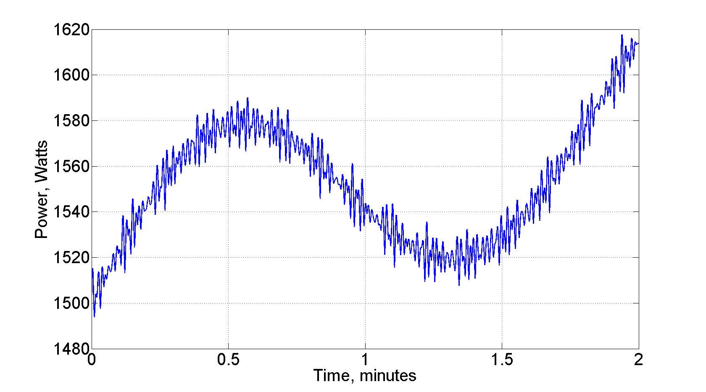
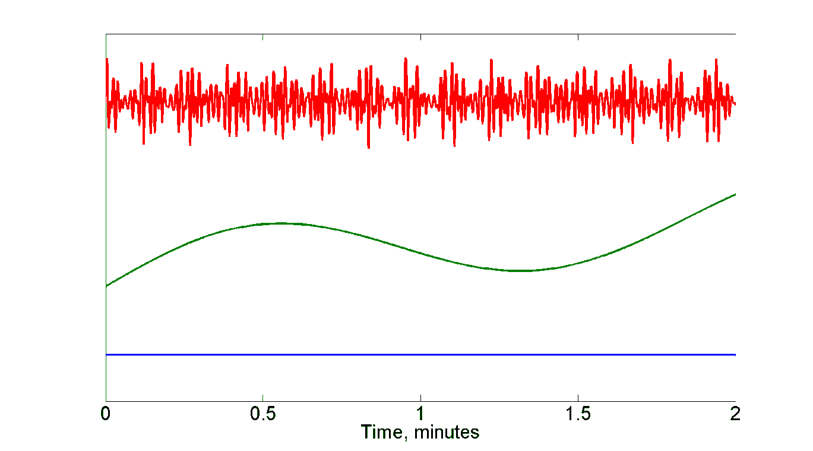
Ancillary Services: Example
Regulation
Fast variations
Load Following
Slow variations
Base Load
Constant

Slide 30
Part 3: Electric Vehicles
Overview
Electric Vehicles on the Distribution Grid
Usage Potentials
Storage Considerations
Implementation Issues

Slide 31
Electric Vehicles – Overview
History
Classifications of Electric Vehicles
Hybrid Electric Vehicle
Plug-in Hybrid Electric Vehicle
Battery Electric Vehicle
Examples
HEV
PHEV
BEV
Current Deployment

Slide 32
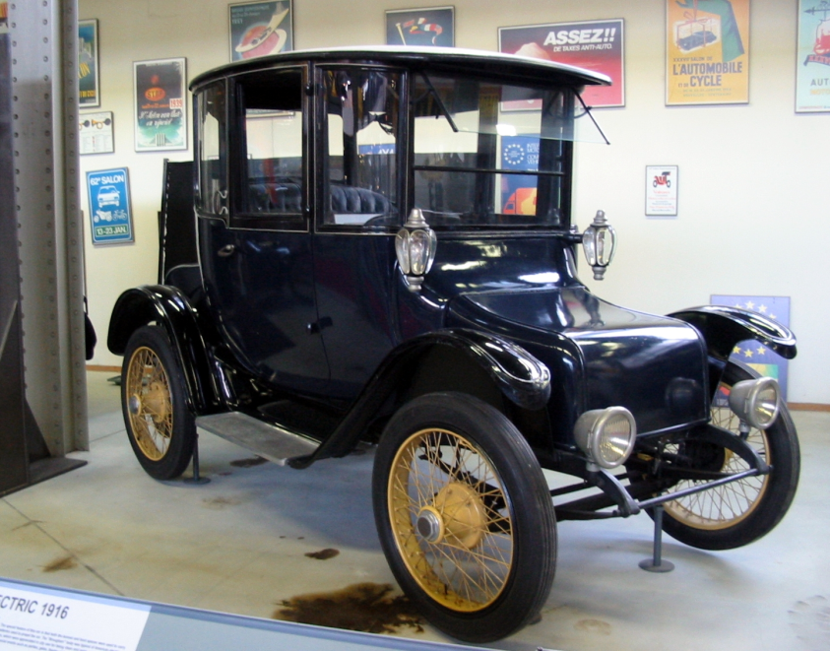
Electric Vehicles – History^{[ref2,ref3]}
Electric vehicles began as early as 1830’s
Thomas Davenport – small drifter – 1835
Robert Davidson – electric locomotive – 1838
Robert Anderson – electric carriage (1830s – exact date unknown)
Late 19th/Early 20th century
Late 19th/Early 20th century
1897 – electric taxis in New York city
Wood’s Phaeton – horseless carriage – 1902
Edison’s Detroit Electric Vehicle – 1907 to 1929
Detroit Edison 1916^{[REF1]}

Slide 33
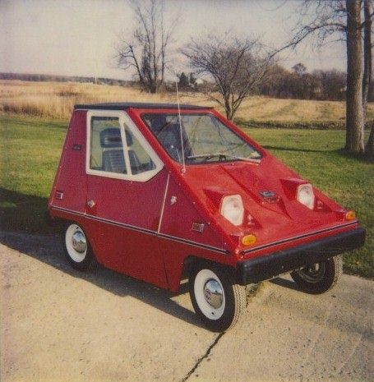
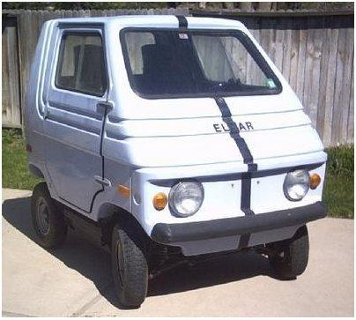
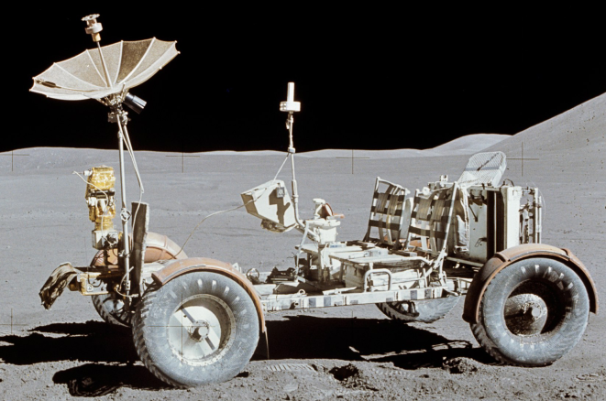
Electric Vehicles – History^{[ref2,ref3]}
CitiCar^{[ref4]}
1920s – 1990s
Decline in electric vehicles
Interstate system required longer range
Mass production made cheaper gas engines (Henry Ford)
Discovery of crude oil deposits made gasoline cheaper
Invention of the electric starter (Kettering – 1912)
Some experiments persisted
Zagato Zele / Elcar – 1975
Sebring-Vanguard CitiCar – 1974 – 1977
Lunar Roving Vehicle – 1971/1972
Elcar^{[ref5]}
Lunar Roving Vehicle^{[ref6]}

Slide 34
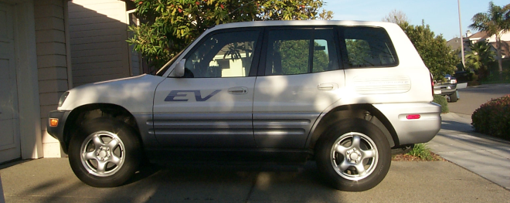
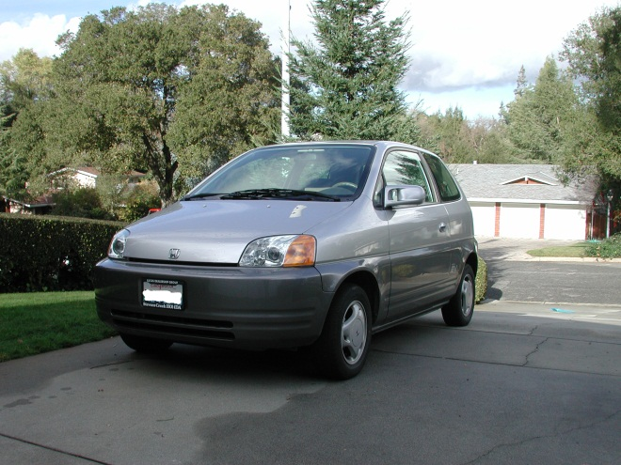
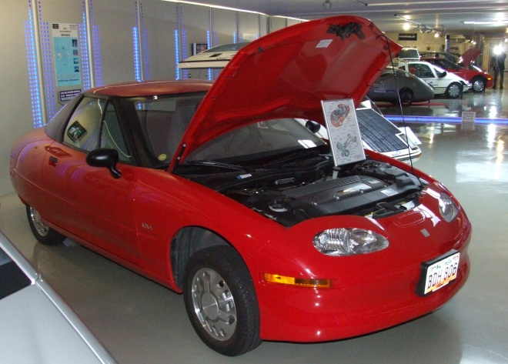
Electric Vehicles – History^{[ref2,ref3]}
1990s
California Air Resources Board (CARB) mandate for “zero emissions vehicles”
General Motors EV1
Toyota RAV4
General Motors S10 EV
Honda EV Plus
Chrysler TEVan
CARB mandate modified
Most vehicles destroyed by manufacturers
328 RAV4s sold to public
Toyota RAV4 EV^{[ref7]}
Honda EV Plus^{[ref8]}
GM EV1^{[ref9]}

Slide 35
Electric Vehicles – History^{[ref2,ref3]}
Late 1990’s to Present
Renewed interest
Battery technology has improved
Petroleum prices risen
Increased public interest in “sustainability”
Reliable Plug-in Hybrid Electric Vehicle technology
Production vehicles becoming available
Tesla Roadster
Nissan Leaf
Chevrolet Volt
Toyota Prius

Slide 36
Electric Vehicles – Classifications
Hybrid Electric Vehicle (HEV)
Combustion engine and electric motor both present
Battery only chargeable via regenerative braking and combustion engine
Plug-in Hybrid Electric Vehicle (PHEV)
Combustion engine and electric motor both present
Battery chargeable through regenerative braking, combustion engine, and via external electrical source (plug)
Battery Electric Vehicle/Electric Vehicle (BEV)
No combustion engine
Battery chargeable via regenerative braking and external electrical source

Slide 37
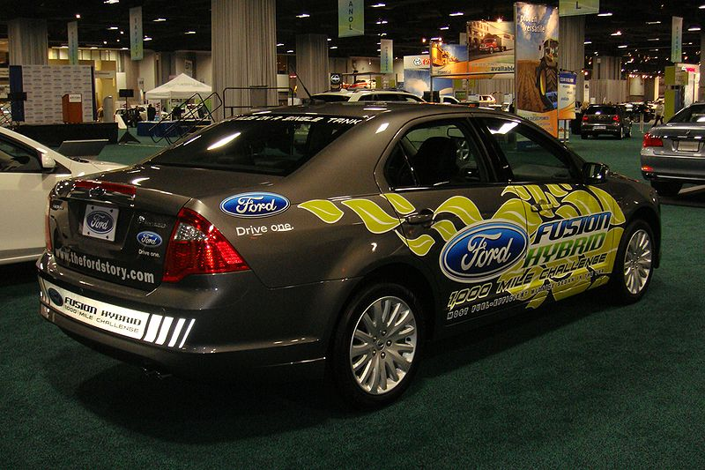
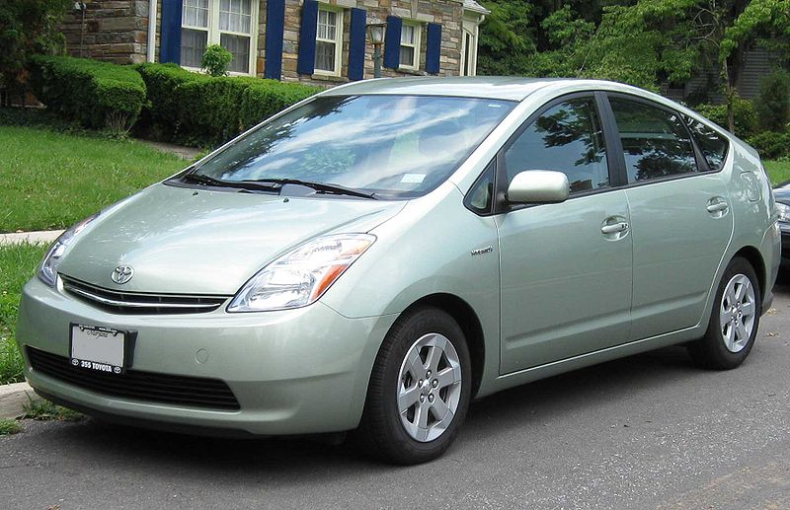
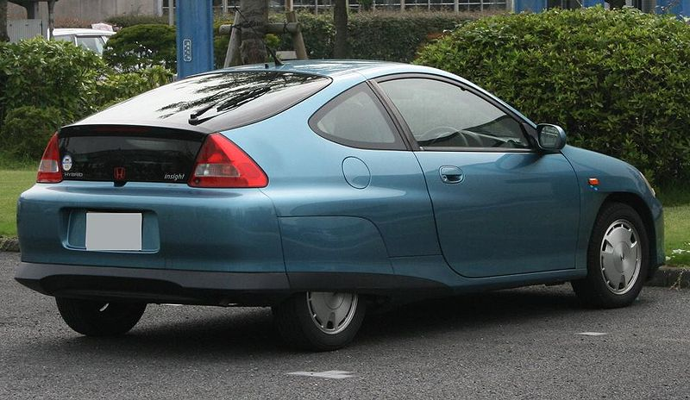
Electric Vehicles – Hybrid Electric Vehicle
Toyota Prius
Honda Insight
Ford Fusion Hybrid
Ford Fusion Hybrid^{[ref11]}
Toyota Prius^{[ref10]}
Honda Insight^{[ref12]}

Slide 38
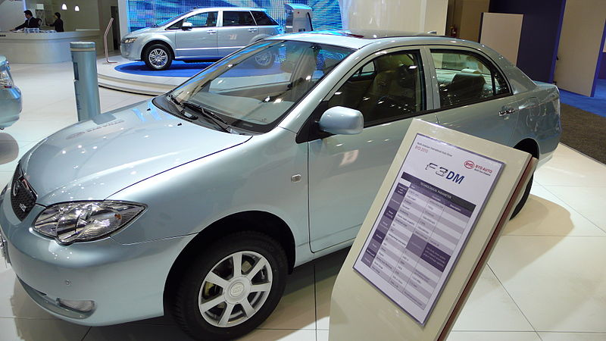
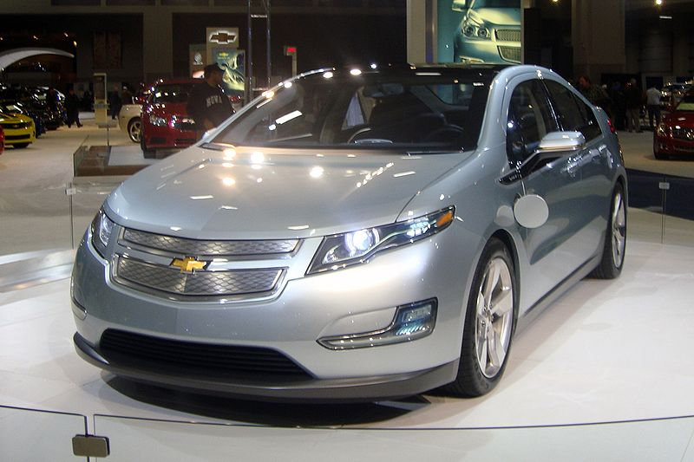
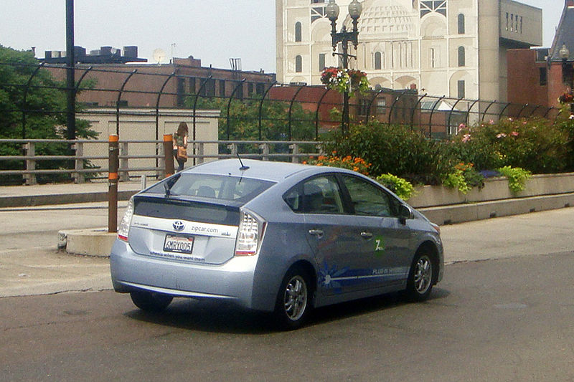
Electric Vehicles – Plug-in Hybrid Electric Vehicle
Chevrolet Volt
Toyota Prius PHEV
BYD F3DM
BYD F3DM^{[ref15]}
Chevrolet Volt^{[ref13]}
Toyota Prius PHEV^{[ref14]}

Slide 39
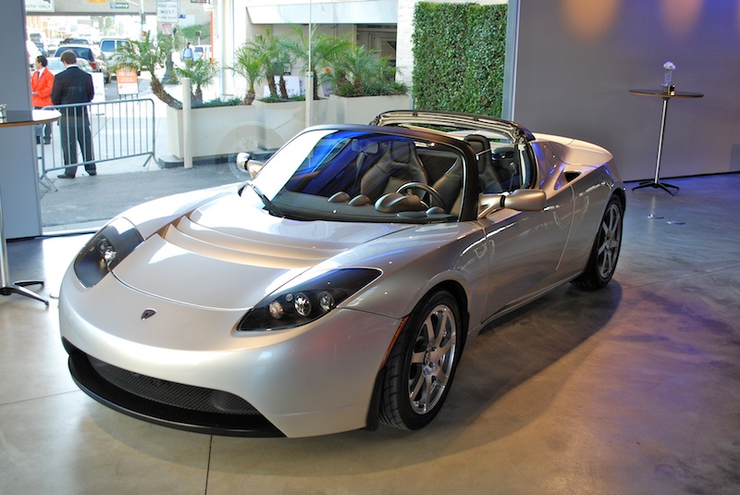
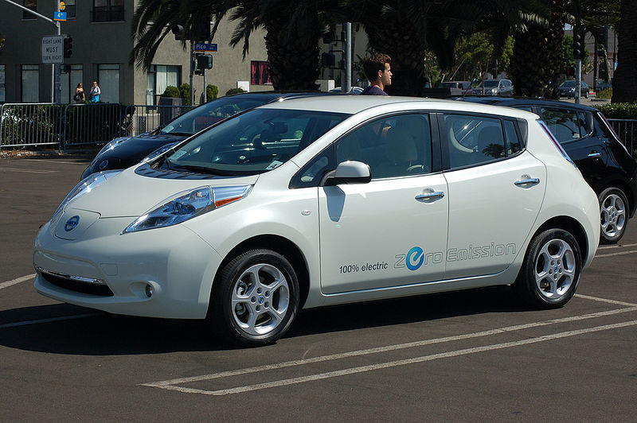

Electric Vehicles – Battery Electric Vehicle
Nissan Leaf
Mini Cooper Mini-E
Tesla Roadster
Tesla Roadster^{[ref18]}
Nissan Leaf^{[ref16]}
Mini Cooper Mini-E^{[ref17]}

Slide 40
Electric Vehicles – Current Deployment^{[ref19]}
Electric Vehicle Numbers
27,000 – Estimated number on the road (2011)
496,000 – Expected number by 2015
Batteries
Li-ion chemistry in most
Capacities vary
Toyota Prius PHEV – 4.4 kWh
Nissan Leaf – 24 kWh
Chevrolet Volt – 16 kWh
Mini Cooper Mini-E – 35 kWh
If 2015 numbers and Chevy Volt battery sizes are used, the grid ideally has access to almost 8 GWh of storage!
Even a small fraction of this is a significant resource for the power grid.

Slide 41
Electric Vehicles on the Distribution Grid
Potential loading issues
Can be equivalent load to an extra hot water heater in the house
Level 1 Charging – 120 VAC @ 16 A = 1.92 kW
Level 2 Charging – 240 VAC @ 32 A = 7.68 kW
240 VAC @ 80 A = 19.2 kW
Distribution system effects
Coincidental loading – commuters all plugging in when come home
Potential to overload distribution transformers
Possible peak generation issues
Solutions
Time-of-use rates for charging
Deferred (timer-based) charging
Regulation charging
Varying resources
Different size batteries
Different capabilities
Adjustable charging rates
Limited by hardware or battery management systems
Ability to charge, maybe ability to discharge

Slide 42
Usage Potential
Overview
Off-peak Storage
Ancillary Services

Slide 43
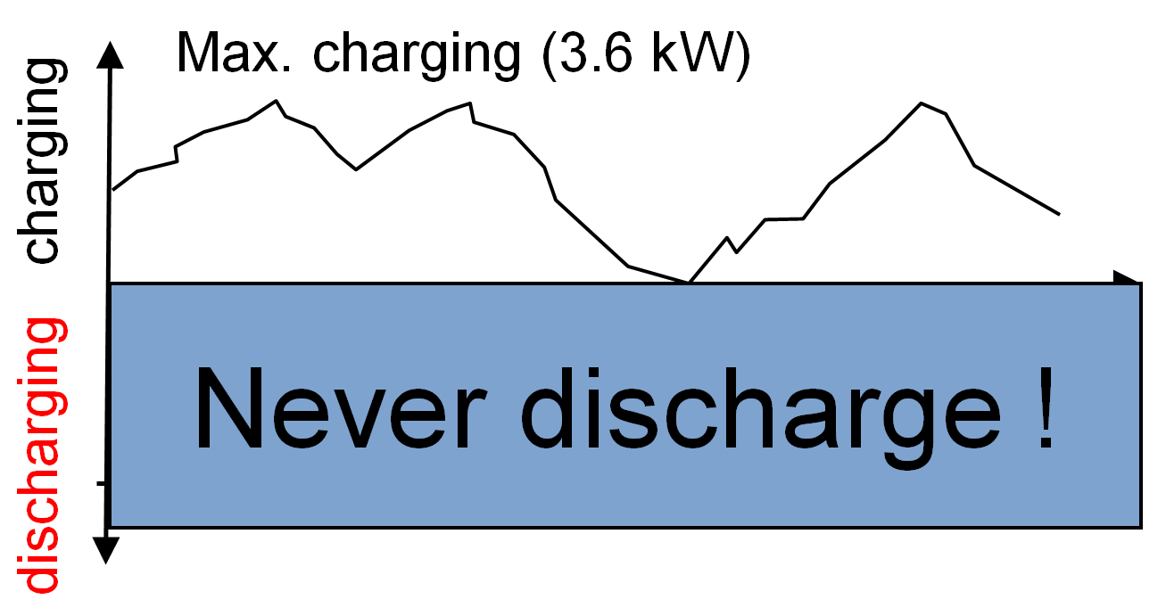
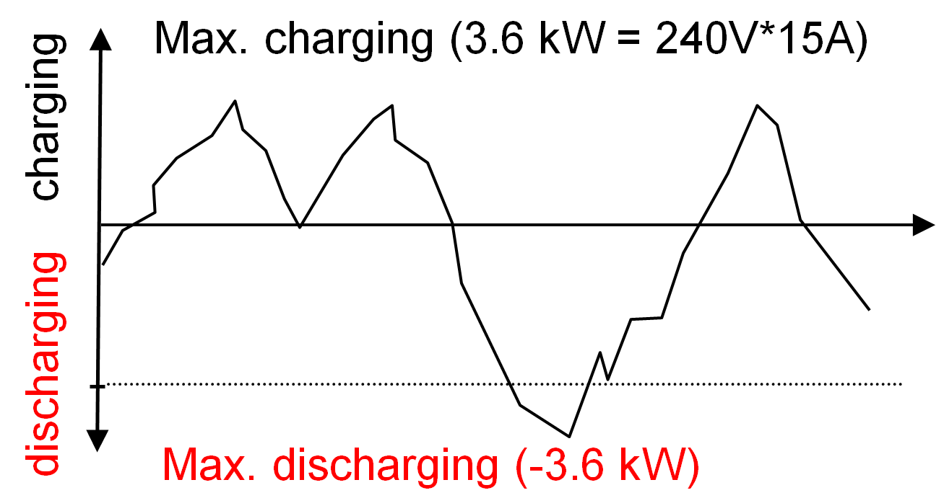
Usage Potential – Overview
Electric vehicles as a grid resource
Potential as load (V2GHalf or G2V)
Charge rate can be varied to meet grid demands
“Load resource” availability dictated by charge needed
Potential as storage (V2GFull or V2G)
Charge rate and discharge rate can be varied to meet grid demands
Ability to discharge after 100% full – maintain longer “grid resource” availability
Electric vehicles as a customer item
Battery capacity
Spontaneous trips
“Charge by” requirements
Compensation for use as grid resource
Control location
Localized
Centralized
V2GHalf or G2V
V2GFull or V2G

Slide 44
Usage Potential – Off-peak Storage
V2G required
Direct Economics
Charge electric vehicle during cheaper night rates
Sell back into grid when prices higher
Feed load from electric vehicle battery
Distributed Renewable Generation
Charge during generation peak
Solar peak – daytime charging
Wind peak – often nighttime charging
Utilize during periods of low generation
Grid Stability
Charge during excess generation
Provide back into grid during generation shortfalls

Slide 45
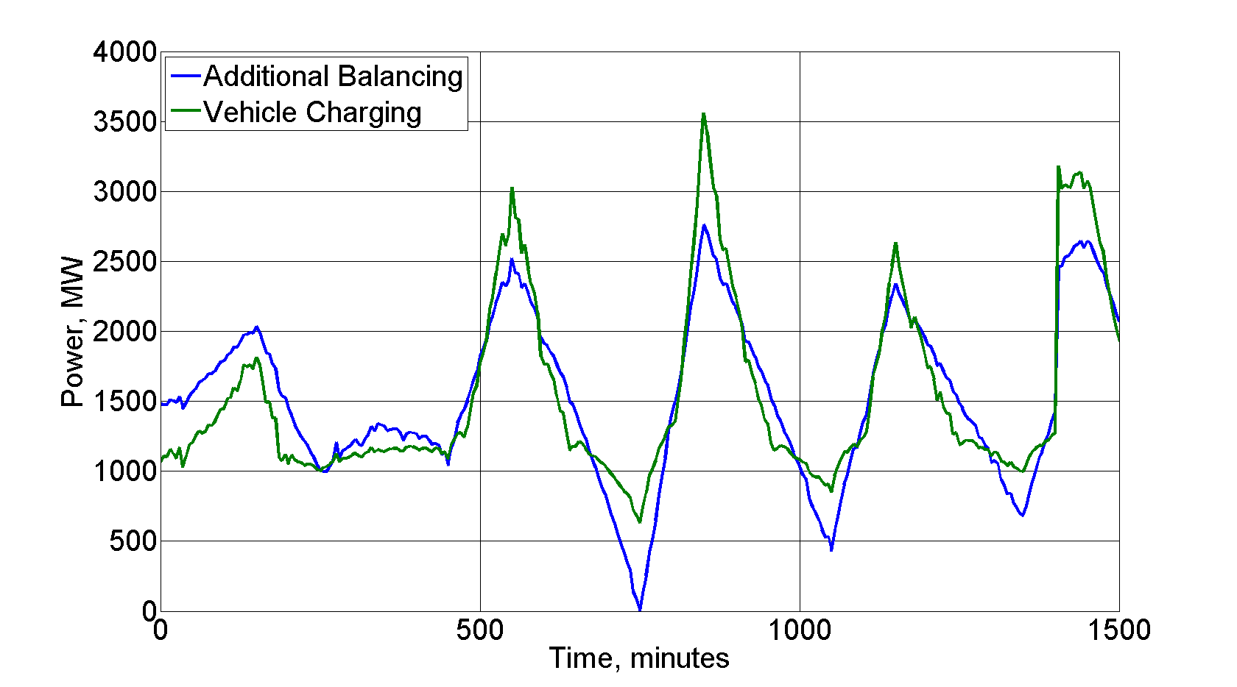
Usage Potential – Ancillary Services
Type of service
Regulation – Fast response time – on the order of 4 seconds
Load following – Slow response time – on the order of 1 to 5 minutes
External control or frequency-based
V2G
Provide both “incremental” and “decremental” power to the grid
Incremental – charge for over-frequency/over-generation
Regulation Services – Balancing^{[ref20]}
Charging follows balancing requirements
Decremental – discharge for under-frequency/under-generation
Ability to maintain availability by discharging after 100% state-of-charge
G2V or V2GHalf
Provide mainly “incremental” power, but supply “apparent decremental”
Incremental – charge for over-frequency/over-generation
Apparent decremental – slow/stop charge rate for under-frequency/under-generation
Resource unavailable once 100% state-of-charge reached

Slide 46
Storage Considerations
Availability Constraints
Customer Requirements
Life Cycle
Battery “Second life” Usage

Slide 47
Storage Considerations – Availability Constraints
Electric vehicles need storage for transportation – not always plugged into the charging station
Customer may have unexpected trips that cause “available” resource to become spontaneously “unavailable”
Local distribution constraints (congestion) may dictate the “availability” of an electric vehicle as storage

Slide 48
Storage Considerations – Customer Requirements
Electric vehicle is a vehicle as a first use – customer may want certain levels of charge by certain times
Dictates charging/discharging rates
Determines resource availability
Customer may override “storage-mode” charging
Pure charging of battery – no grid services
If expected as part of aggregation, will alter estimates
Customer may only connect when charging – no idle connections
Limits availability of electric vehicle as resource
Limits flexibility on charging scenarios due to time constraints

Slide 49
Storage Considerations – Life Cycle
Potential life cycle influences
Extra charge/discharge cycles associated with grid use may shorten the life of the battery
Shallow discharge/charge cycles of regulation services may limit battery life
Excess cycling causing thermal considerations (overheating)
Overall effects
Limit battery life as a “traction” battery
Voiding of battery/automotive warranty
Extra cycles on charging/discharging equipment

Slide 50
Storage Considerations – “Second Life” Usage
Batteries “unfit” for transportation usage still have significant capacity
Useful for community energy storage projects
Smaller (backyard or pad placement)
“Safe” – built for automotive use, so various containment/safety mechanisms in place
Reduces environmental impact of batteries by extending their useful life
Incentives to customers
Deals with utility/automotive manufacturers to recoup costs
On-site energy storage

Slide 51
Implementation Issues
Availability/Customer Requirements
Hardware Location
Novelty

Slide 52
Implementation Issues – Availability/Customer Requirements
Availability dictated by when car is plugged in and has free charge capacity
Range anxiety may force “charge now” option always
Vehicle may not be connected when not charging – limits potential for emergency grid usage
Shorter commutes and constant charging may naturally limit electric vehicle as a resource
Customer travel expectations
Certain battery capacity by certain time (“charge by”) – drives overall charge/discharge cycle
Spontaneous trips – capacity to take these trips expected
Customer ownership
Incentives for usage of their vehicle
Relinquishment of control over charging (if centrally aggregated)
Additional wear and tear on battery and components

Slide 53
Implementation Issues – Hardware Location
Storage usage control
Centrally located
Communications channel to aggregator
Additional hardware to handle communications
Decentralized
Cheaper, local hardware
Not as coordinated
Local hardware location
Electric Vehicle Supply Equipment
Not located on car
Higher infrastructure costs
Location tied, not vehicle tied
Electric Vehicle
Located on car
Higher vehicle costs
Follows vehicle – if appropriate service is available
Split
Higher costs on both sides
Communications over charging cable or some other medium

Slide 54
Implementation Issues – Novelty
Electric vehicles relatively new to modern market
Range anxiety issues most prevalent fear – manufacturers want to avoid anything that may augment this fear
Vehicle fails to meet 100% state-of-charge due to excess grid needs
Long discharge cycle occurs right before “spontaneous” trip
Limit impacts on battery that may shorten range/life
Create overall positive experience towards electric vehicles
Interview process to determine “understanding candidates” – Leaf and Mini-E
Limit factors to alter this experience – use as storage device introduces unknowns
Electric vehicles typically more expensive that gasoline counterparts
Additional “storage-capable” hardware increases price
Utility incentives may offset, but not always available

Slide 55
Sources
[1] Boyes, J.D.; Clark, N.H.; , "Technologies for energy storage. Flywheels and super conducting magnetic energy storage," Power Engineering Society Summer Meeting, 2000. IEEE , vol.3, no., pp.1548-1550 vol. 3, 2000 doi: 10.1109/PESS.2000.868760 URL: http://ieeexplore.ieee.org/stamp/stamp.jsp?tp=&arnumber=868760&isnumber=18790
[2] Ribeiro, P.F.; Johnson, B.K.; Crow, M.L.; Arsoy, A.; Liu, Y.; , "Energy storage systems for advanced power applications," Proceedings of the IEEE , vol.89, no.12, pp.1744-1756, Dec 2001 doi: 10.1109/5.975900 URL: http://ieeexplore.ieee.org/stamp/stamp.jsp?tp=&arnumber=975900&isnumber=21066
[3] Jason’s Slides

Slide 56
[4] http://hydro.org/tech-and-policy/technology/pumped-storage/
[5] Taylor, J.; Halnes, A.; , "Analysis Of compressed air energy storage," PCIC Europe 2010 Conference Record , vol., no., pp.1-5, 15-17 June 2010 URL: http://ieeexplore.ieee.org/stamp/stamp.jsp?tp=&arnumber=5525746&isnumber=5525727
[6] Dunn, R. I.; Hearps, P. J.; Wright, M. N.; , "Molten-Salt Power Towers: Newly Commercial Concentrating Solar Storage," Proceedings of the IEEE , vol.PP, no.99, pp.1-12, 0 doi: 10.1109/JPROC.2011.2163739 URL: http://ieeexplore.ieee.org/stamp/stamp.jsp?tp=&arnumber=6035949&isnumber=4357935
[7] http://www.ultracapacitors.org/index.php?option=com_content&Itemid=57&id=37&task=view

Slide 57
Sources
[4] http://hydro.org/tech-and-policy/technology/pumped-storage/
[5] Taylor, J.; Halnes, A.; , "Analysis Of compressed air energy storage," PCIC Europe 2010 Conference Record , vol., no., pp.1-5, 15-17 June 2010 URL: http://ieeexplore.ieee.org/stamp/stamp.jsp?tp=&arnumber=5525746&isnumber=5525727
[6] Dunn, R. I.; Hearps, P. J.; Wright, M. N.; , "Molten-Salt Power Towers: Newly Commercial Concentrating Solar Storage," Proceedings of the IEEE , vol.PP, no.99, pp.1-12, 0 doi: 10.1109/JPROC.2011.2163739 URL: http://ieeexplore.ieee.org/stamp/stamp.jsp?tp=&arnumber=6035949&isnumber=4357935
REF1, Asterion, “Detroit Electric 1916”, Wikipedia, Dec. 2006, URL: http://en.wikipedia.org/wiki/File:Detroit_Electric_1916.jpg
REF2, Wikipedia contributors, "History of the electric vehicle," Wikipedia, //en.wikipedia.org/w/index.php?title=History_of_the_electric_vehicle&oldid=454559473 (accessed October 12, 2011)
REF3, Department of Energy – Energy Efficiency & Renewable Energy, “History of Electric Vehicles,” URL: http://www1.eere.energy.gov/vehiclesandfuels/avta/light_duty/fsev/fsev_history.html, (accessed October 12, 2011)
REF4, D0li0, “Citicar”, Wikipedia, URL: http://en.wikipedia.org/wiki/File:Citicar.jpg
REF5, Mike Chancey, “Harry van Soolen’s 1974 Zagato Elcar”, Sept. 25, 2010, URL: http://evalbum.com/1832
REF6, NASA – Eric M. Jones, “Apollo 15 Map and Image Library”, Aug 29, 2011, URL: http://www.hq.nasa.gov/office/pao/History/alsj/a15/images15.html
REF7, George Manning, “Toyota RAV4 EV”, March 2001, URL: http://en.wikipedia.org/wiki/File:Toyota_RAV_4_EV.jpg
REF8, Evplus, “1997-1999 Honda EV Plus”, Aug 2007, URL: http://en.wikipedia.org/wiki/File:1997-1999_Honda_EV_Plus_02.jpg
REF9, Claus Ableiter, “General Motors EV1”, Oct 2008, URL: http://en.wikipedia.org/wiki/File:General_Motors_EV1_im_Museum_Autovision.jpg
REF10, IFCAR, “2004-2008 Toyota Prius”, Jun 2008, URL: http://en.wikipedia.org/wiki/File:2nd_Toyota_Prius.jpg
REF11, Mario Roberto Duran Ortiz, “2010 Ford Fusion Hybrid promotional vehicle”, Jan 2010, URL: http://en.wikipedia.org/wiki/File:2010_Ford_Fusion_Hybrid_WAS_2010_8962.JPG
REF12, 本人撮影, “Honda Insight Back”, Jul 2007, URL: http://en.wikipedia.org/wiki/File:Honda_Insight_Back.JPG
REF13, Mario Roberto Duran Ortiz, “2011 Chevrolet Volt”, Jan 2010, URL: http://en.wikipedia.org/wiki/File:Chevrolet_Volt_WAS_2010_8852.JPG
REF14, Mario Roberto Duran Ortiz, “Toyota Prius Plug-In Hybrid demonstration vehicle”, Jul 2011, URL: http://en.wikipedia.org/wiki/File:BOS_07_2011_Prius_PHEV_ZipCar_2830.jpg
REF15, Anthonares, “BYD F3DM plug-in hybrid”, URL: http://en.wikipedia.org/wiki/File:Byd_f3_dm.jpg
REF16, Richard Kelly, “Nissan Leaf ‘Glacier Pearl’ White”, Oct 2010, URL: http://en.wikipedia.org/wiki/File:Nissan_LEAF_Glacier_Pearl_White.jpg
REF17, Bill Bicholls, “Electric MINI”, Feb 2010, URL: http://en.wikipedia.org/wiki/File:An_Electric_MINI_-_geograph.org.uk_-_1710621.jpg
REF18, Plug In America, “Tesla Roadster electric car”, May 2008, URL: http://en.wikipedia.org/wiki/File:Tesla_Roadster_electric_car_DSC_0160.jpg
REF19, Kim Hill and Joshua Cregger, “Deployment Rollout Estimate of Electric Vehicles 2011-2015”, Center for Automotive Research, Jan 2011, URL: http://www.cargroup.org/pdfs/deployment.pdf
REF20, Francis Tuffner and Michael C. W. Kintner-Meyer, “Using Electric Vehicles to Meet Balancing Requirements Associated with Wind Power,” PNNL-20501 Report. Pacific Northwest National Laboratory. Richland, WA, July 2011.

